Slide 1
Heart Disease
Goal: Predict whether this specific individual has heart disease based on given characteristics.

Slide 2
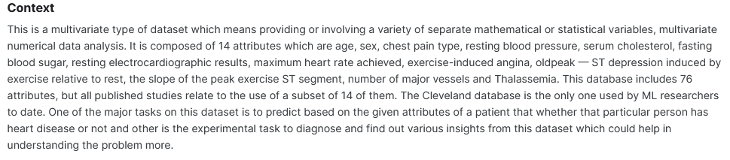
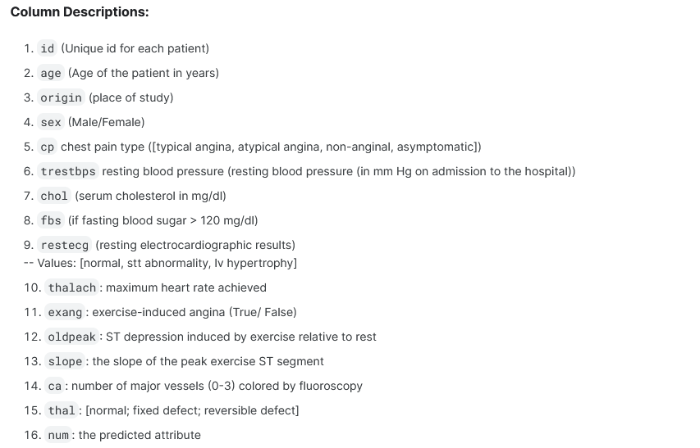

Slide 3
Preprocessing
Numeric features were filled using a method of grouping and obtaining median values, while extreme low or high values were removed or replaced.
Categorical features were handled in the same way as numeric ones.
For features with a significant number of missing values, various imputation methods were used (filled using the first method or random values between min and max).
After filling the missing values, the data was converted to the appropriate data type

Slide 4
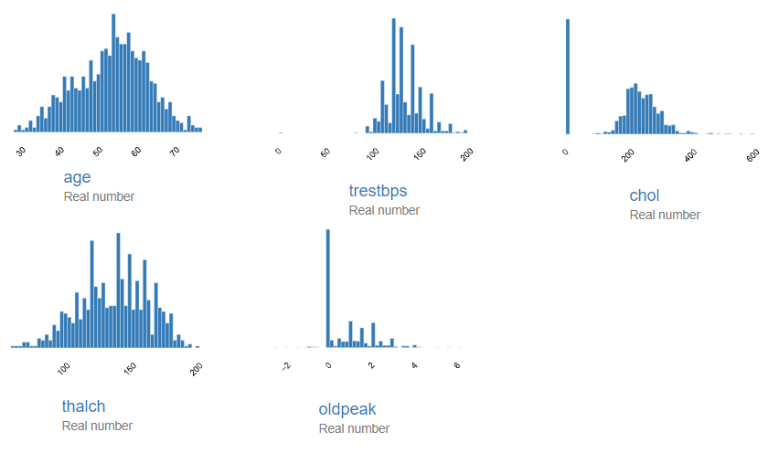
Preprocessing

Slide 5
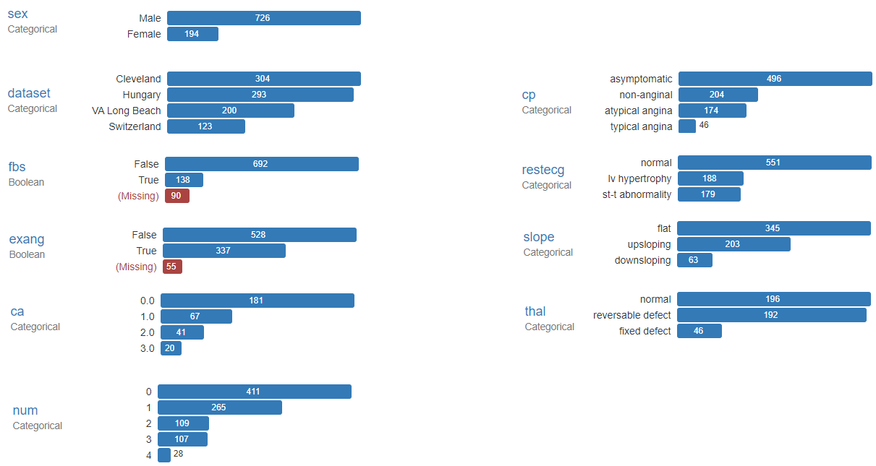
Preprocessing

Slide 6
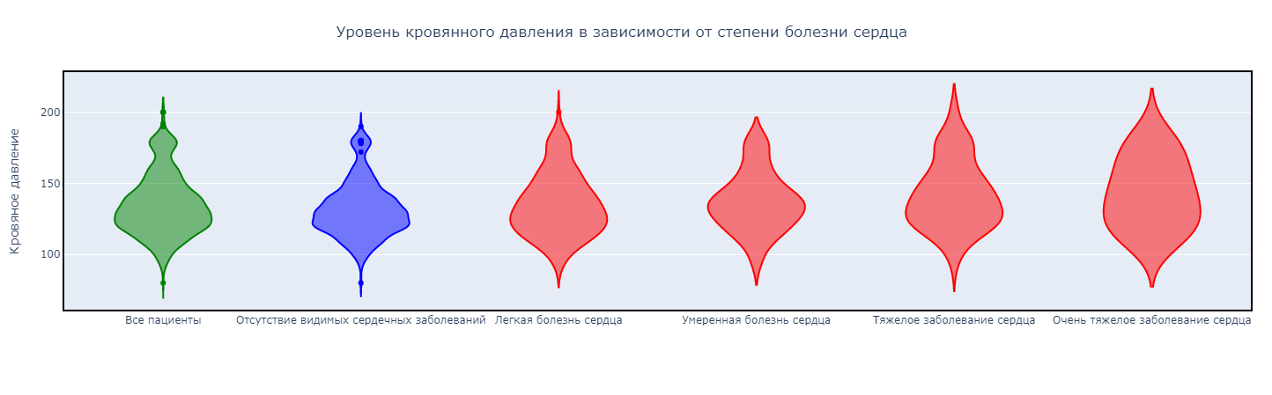
Exploratory Data Analysis (EDA)
In cases of heart disease, the lower threshold of blood pressure starts at 80 and increases from 90 upwards depending on the severity of the condition. The median value also escalates accordingly

Slide 7
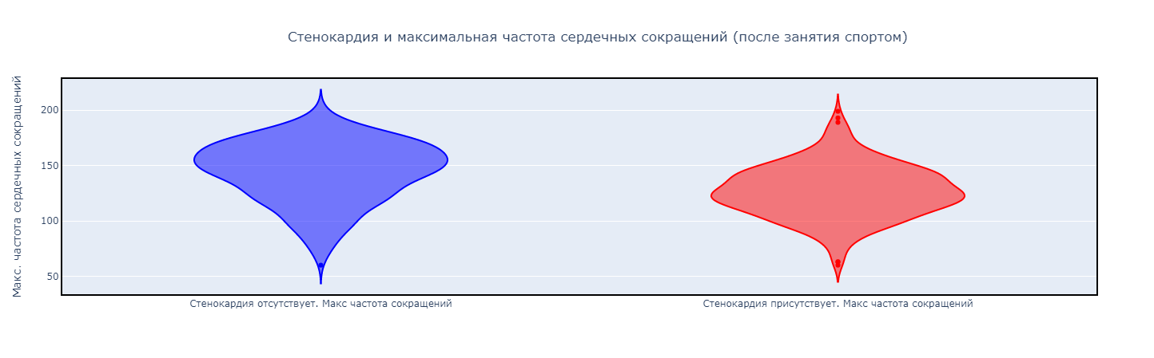
Exploratory Data Analysis (EDA)
In cases of angina, the maximum heart rate is lower on average, but there are individual maximum/minimum values that significantly deviate from the overall pattern.
Among individuals with angina, the percentage of affected individuals is considerably higher compared to those without it:
With angina - 83.47%
Without angina - 36.98%

Slide 8
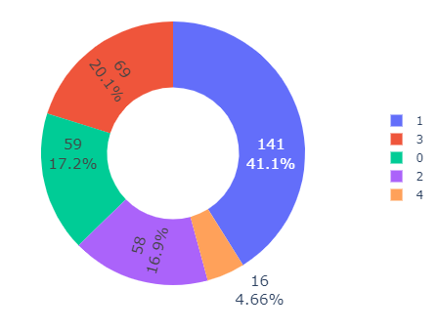
Exploratory Data Analysis (EDA)
Angina in relation to the degree of heart disease
0 - No visible heart disease
1 - Mild heart disease
2 - Moderate heart disease
3 - Severe heart disease
4 - Very severe heart disease

Slide 9
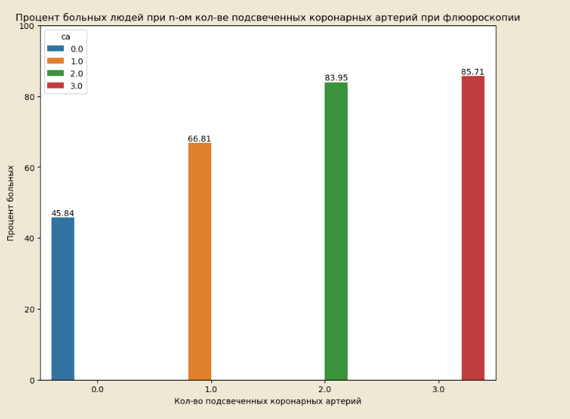
Exploratory Data Analysis (EDA)
The percentage of affected individuals based on the number of highlighted coronary arteries during fluoroscopy:
The more coronary arteries highlighted during fluoroscopy, the higher the likelihood of heart-related issues:
0 - 45.84%
1 - 66.81%
2 - 83.95%
3 - 85.71%

Slide 10
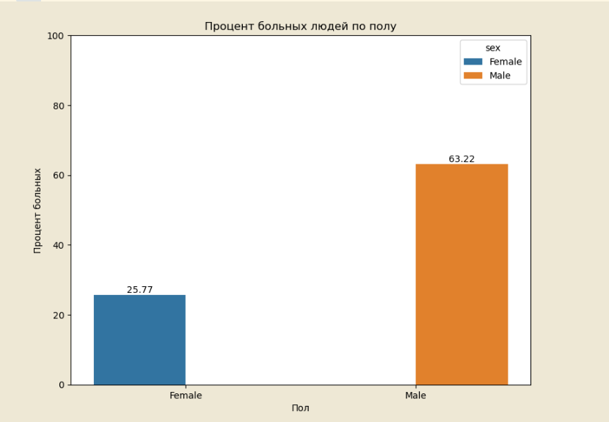
Exploratory Data Analysis (EDA)
Coronary heart disease (CHD) in relation to gender:
Percentage of affected individuals:
Men - 63.22%
Women - 25.77%

Slide 11
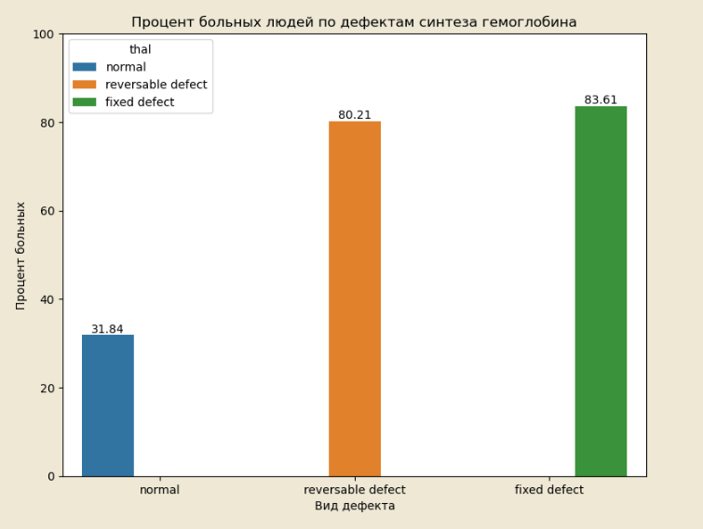
Exploratory Data Analysis (EDA)
Thal (Thalassemia) - Thalassemia is a group of congenital microcytic hemolytic anemias characterized by defective hemoglobin synthesis:
In the case of any deviation from the normal level of hemoglobin synthesis, the percentage of heart disease in an individual becomes significant:
Fixed defect - 83.61%
Normal - 31.84%
Reversible defect - 80.21%

Slide 12
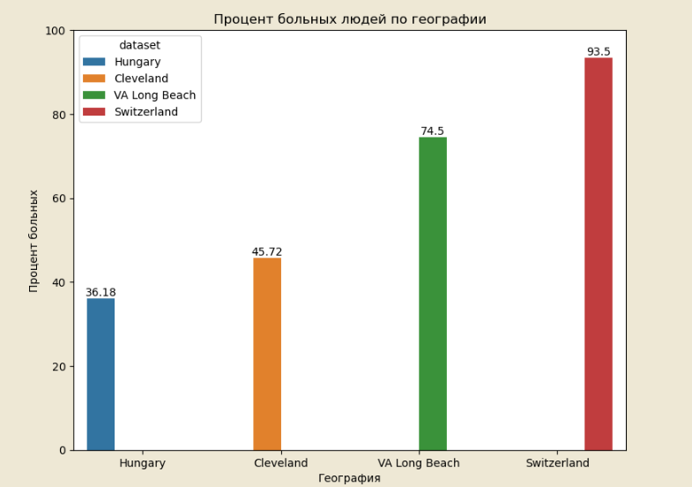
Exploratory Data Analysis (EDA)
Percentage of affected individuals by geography:
Cleveland - 45.72%
Hungary with the least number of affected - 36.18%
Switzerland surpassed all with 93.50%
Virginia comes second with 74.5% affected individuals

Slide 13
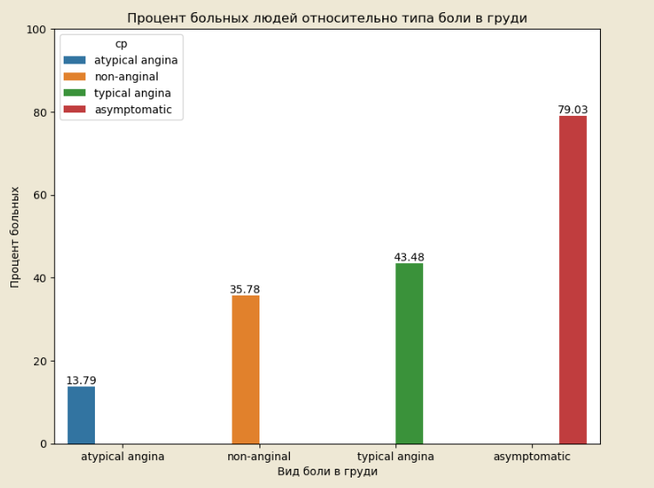
Exploratory Data Analysis (EDA)
Percentage of affected individuals based on different types of chest pain.

Slide 14
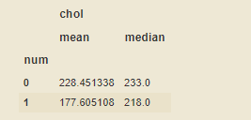
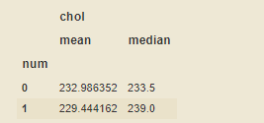
Portrait of an Afflicted Individual
Male:
Aged over 55
From Switzerland or Virginia
Fasting glucose level above normal
Lower maximum heart rate
Low cholesterol (If Switzerland is removed, then it doesn't matter)
Presence of exercise-induced angina
An abnormally low ST deviation less than -1.1 or greater than 4.2
Defects in hemoglobin synthesis
Highlighted coronary arteries during fluoroscopy
Maximum ST depression during exercise not sloping upwards
Data from Switzerland
2. Data excluding Switzerland

Slide 15
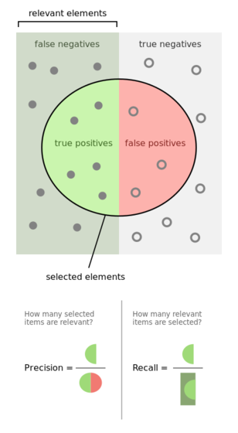
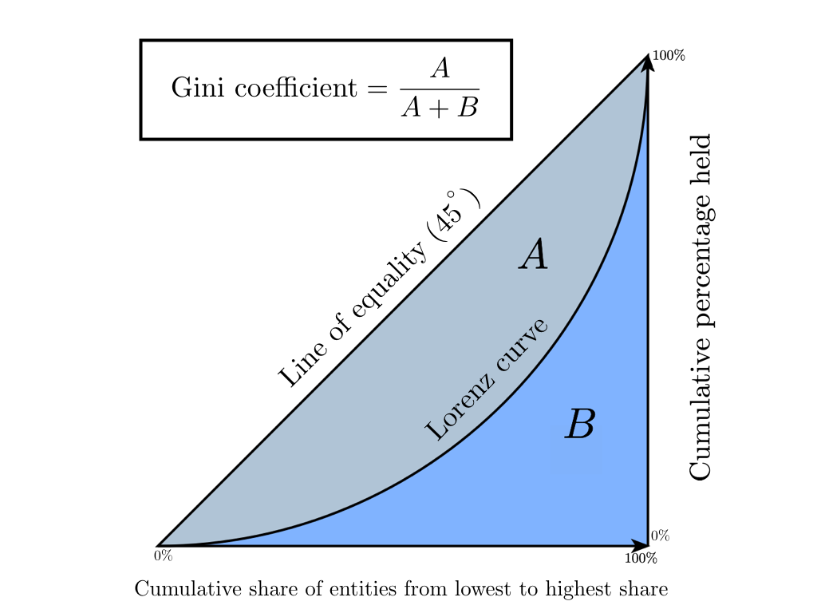
Results
As baseline models, the following were chosen:
Decision Tree
Random Forest
Logistic Regression
K-Nearest Neighbors (KNN)
Before tune:
1: Recall - 81%
After tune:
1: Recall 91.2%
Best model: RandomForestClassifier
Hyperparameters tuned using Optuna:
class_weight = {1:1,0:1.2}
random_state = 7
criterion='gini'
max_depth=10
n_estimators=160

